Slide 1
Computational Text Analysis
Christopher Barrie
Week 3

Slide 2
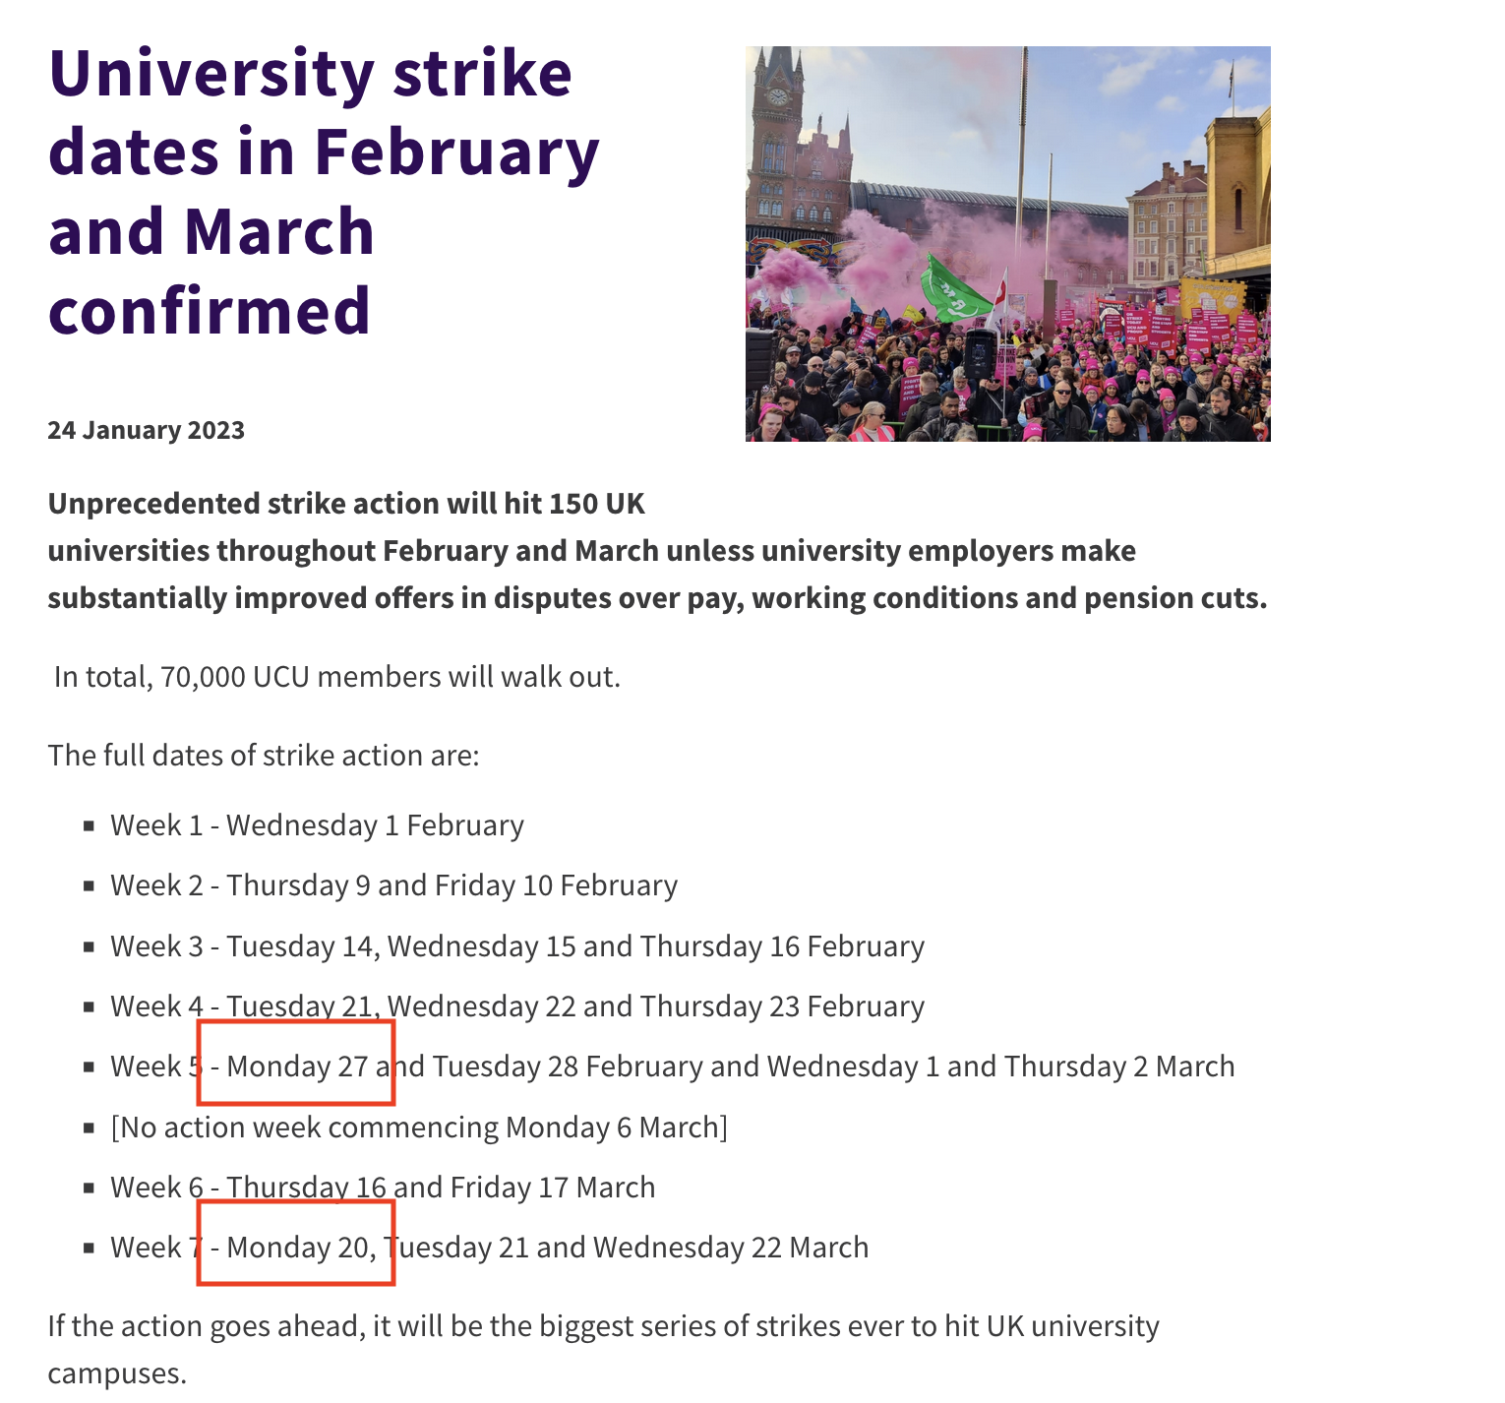

Slide 3
Introduction

Slide 4
A reminder:
Word frequency analysis requires three essential steps:
Tokenizing
Counting words over space/time
Denominating by totals

Slide 5
Sentiment analysis
Sentiment analysis requires:
Tokenizing
Counting words with a dictionary over space/time (or other unit…)
Denominating by totals

Slide 6
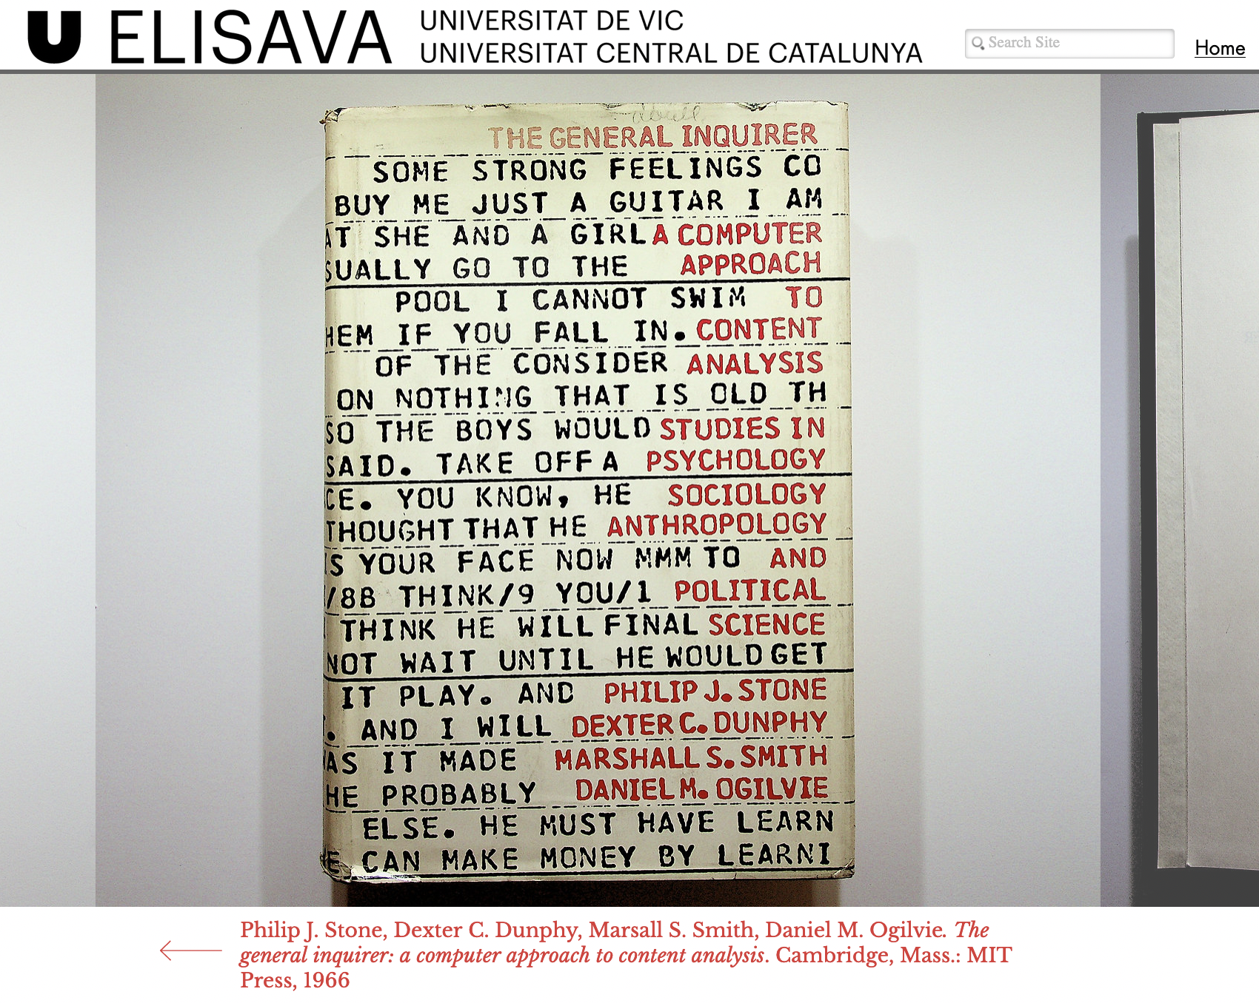

Slide 7
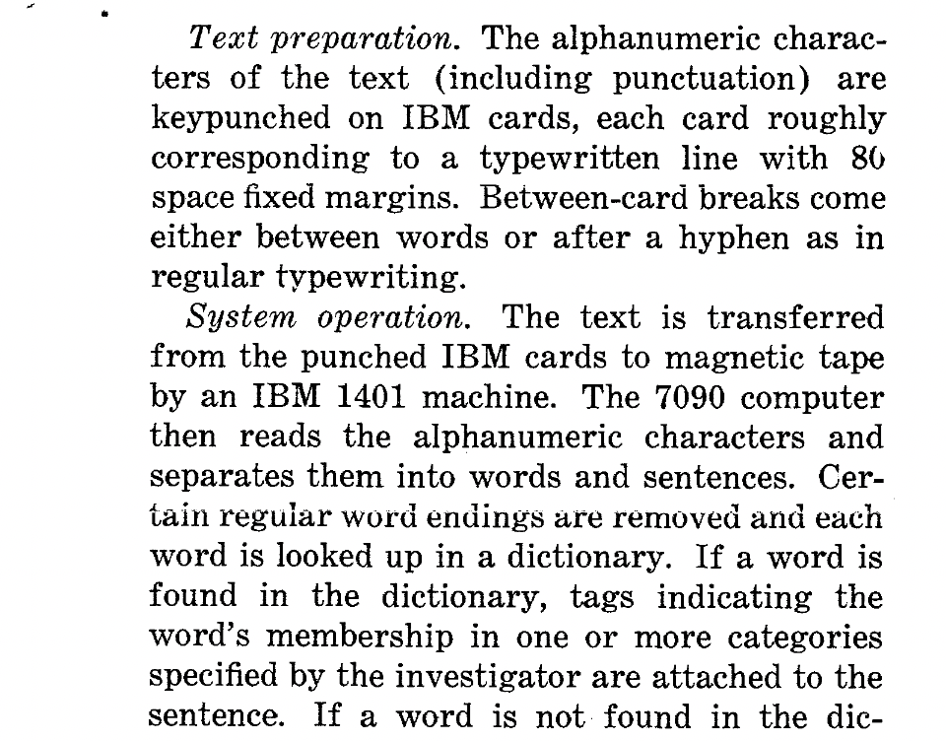

Slide 8
An example
Tokenizing:
“We are all very happy to be at a lecture at 10AM”

Slide 9
An example
Tokenizing:
“We are all very happy to be at a lecture at 10AM”
“We” “are” “all” “very” “happy” “to” “be” “at” “a” “lecture” “at” “10AM”

Slide 10
An example
Counting words over space/time
“We” “are” “all” “very” “happy” “to” “be” “at” “a” “lecture” “at” “10AM”
= 12 words
Now imagine we had our collective thoughts over every lecture this semester:
Class 2: “We” “are” “all” “very” “happy” “to” “be” “at” “a” “lecture” “at” “10AM” “I” “am” “furious” “to” “be” “at” “a” “lecture” “at” “10AM” “why” “am” “I” “awake” “before” “the” “sun” “where” “is” “the” “sun” “I” “need” “some” “vitamin” “D” “is” “there” “a” “Boot’s” “nearby” “what” “was” “he” “saying” “just” “then”... Class 10: “hooray” “it’s” “over”
= ~ 5000 words

Slide 11
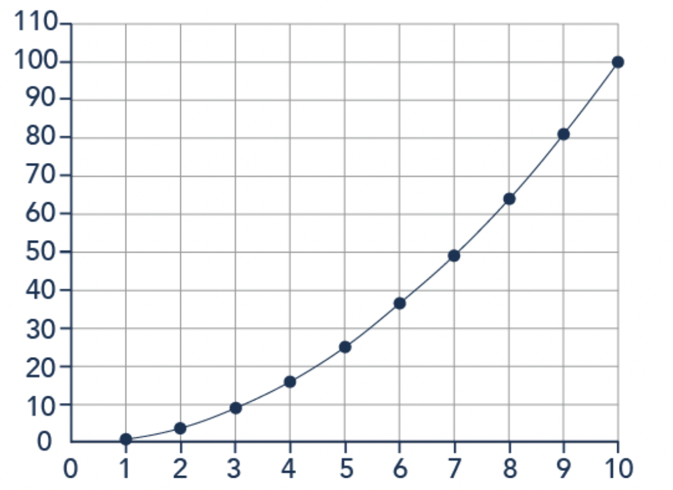
An example
Counting words over time
Count all words for each time unit t (here: our classes)
Count all words denoting a word of interest (here: “happy”)
Happy word freq.
Class no.

Slide 12
An example
Denominating by totals
What if the trend of total words shared over the course of the coming weeks was also positive?
Total word freq.
Then what…?
Class no.

Slide 13
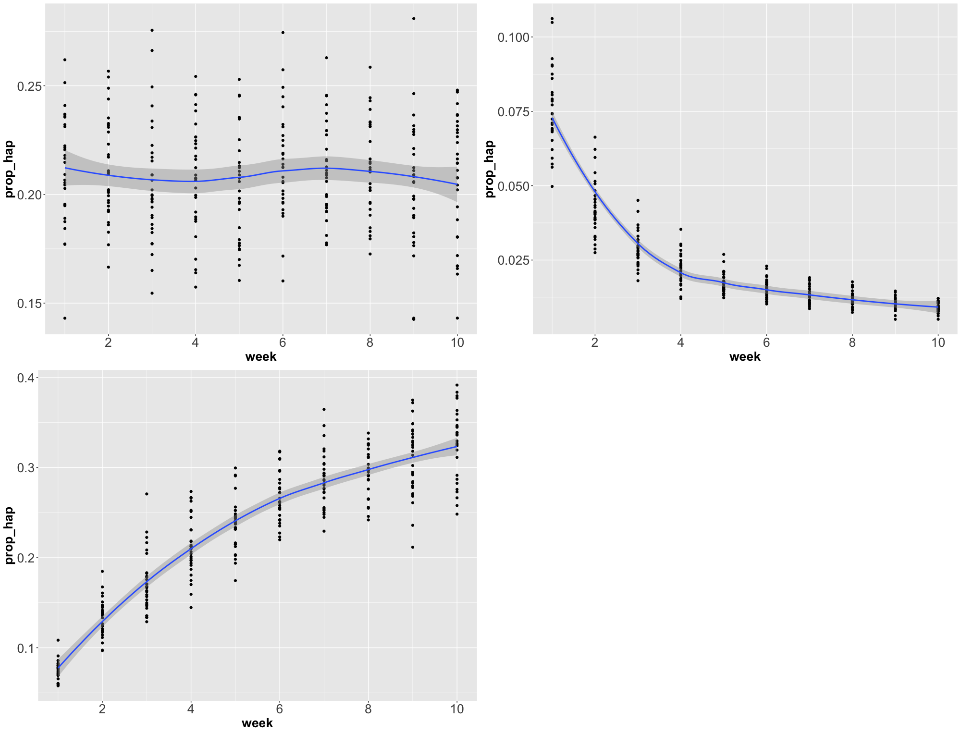
And everywhere in between…

Slide 16
An example
Denominating by totals
What if we also had lots of words indicating other types of sentiment.
E.g., a typical phrase like “I was furious to be at a lecture at 10AM but I was filled with utter joy and elation upon entering the classroom…”
And then we counted up words denoting sentiment…?
Ideas?

Slide 17
An example
Denominating by totals
“I was furious to be at a lecture at 10AM but I was filled with utter joy and elation upon entering the classroom…”
+ 2 “happy” words
+ 1 “unhappy” words
+ 23 total words
2/23 = .087…
1/12 = .044…

Slide 18
An example
Generating a ratio variable
A ratio (~ equivalent of denominating) of positive: sentiment
I.e. 2-1 = 1 overall sentiment score interpretation?

Slide 19
An example
Generating a ratio variable
A ratio (~ equivalent of denominating) of positive: sentiment
I.e. 2-1 = 1 overall sentiment score interpretation?
OR 2/1 = 2 or 1.5x interpretation?

Slide 20
An example
Generating a ratio variable
A ratio (~ equivalent of denominating) of positive: sentiment
I.e. 2-1 = 1 overall sentiment score interpretation?
OR 2/1 = 2 or 1.5x interpretation?
OR 2 - 1/ 2 + 1 = ⅓ for a happy-sad ratio interpretation?
A la Martins and Baumard… what might we miss by not denominating by all words?

Slide 21
An example
Generating a ratio variable
A ratio (~ equivalent of denominating) of positive: sentiment
I.e. 2-1 = 1 overall sentiment score interpretation?
OR 2/1 = 2 or 1.5x interpretation?
OR 2 - 1/ 2 + 1 = ⅓ for a happy-sad ratio interpretation?
A la Martins and Baumard
OR (2-1/23) - (1-2/23) = .087 for percentage point score interpretation?
A la Young and Soroka

Slide 22
An example
Generating a ratio variable
A ratio (~ equivalent of denominating) of positive: sentiment
I.e. 2-1 = 1 overall sentiment score interpretation?
OR 2/1 = 2 or 1.5x interpretation?
OR 2 - 1/ 2 + 1 = ⅓ for a happy-sad ratio interpretation?
A la Martins and Baumard
OR (2-1/23) - (1-2/23) = .087 for percentage point score interpretation?
A la Young and Soroka
OR tf-idf... here: log(1+2) * log(1/1), but imagine lots of documents in the denominator interpretation?
A la Loughran and McDonald

Slide 23
So why is all this relevant?

Slide 24
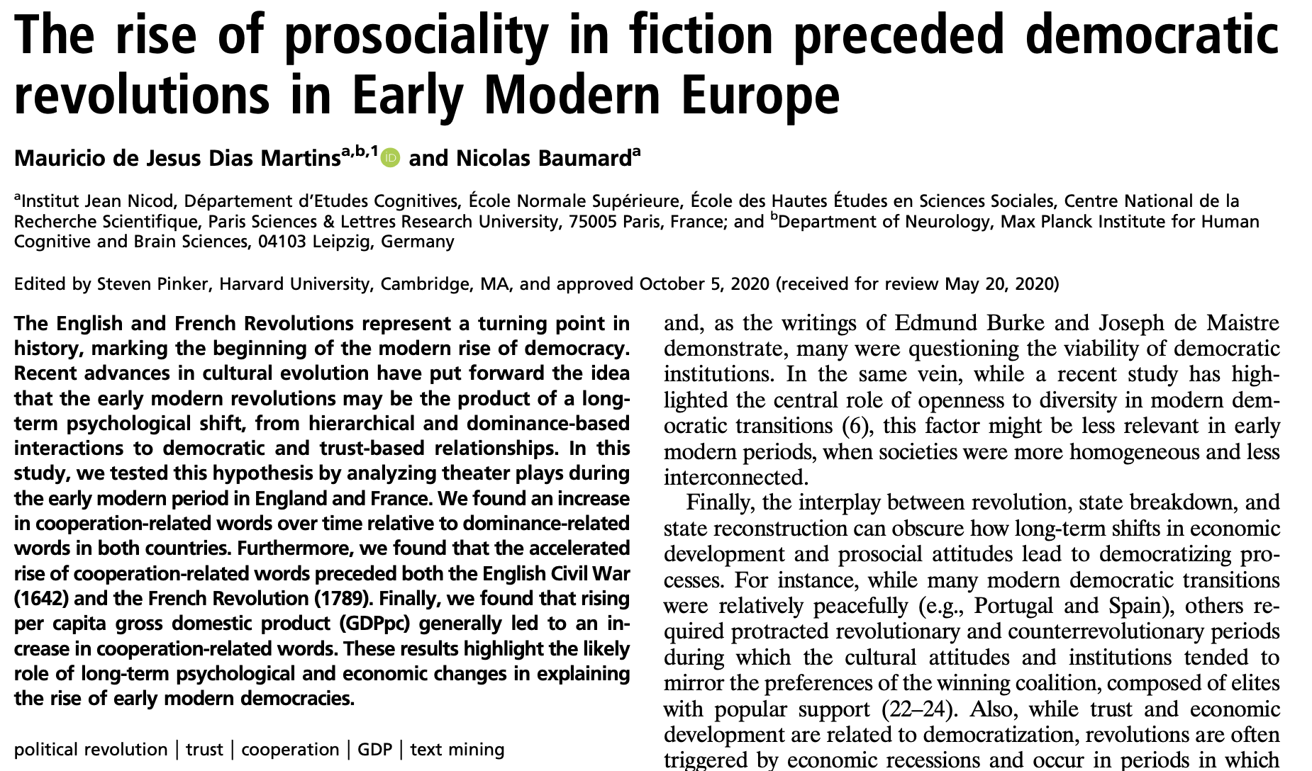
Sentiment analysis examples
The rise of prosociality in fiction preceded democratic revolutions in Early Modern Europe.
Martins and Baumard 2020. PNAS.

Slide 25
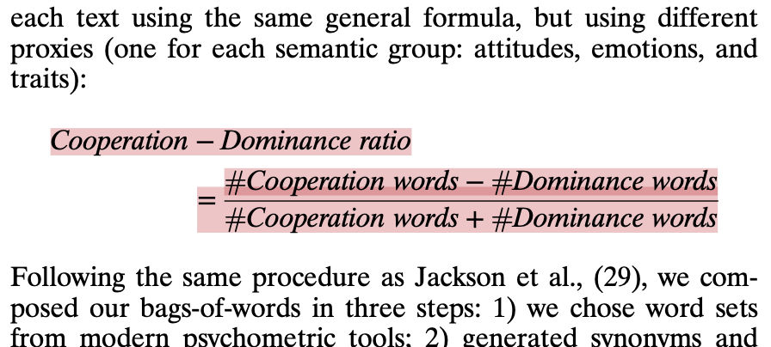

Slide 26
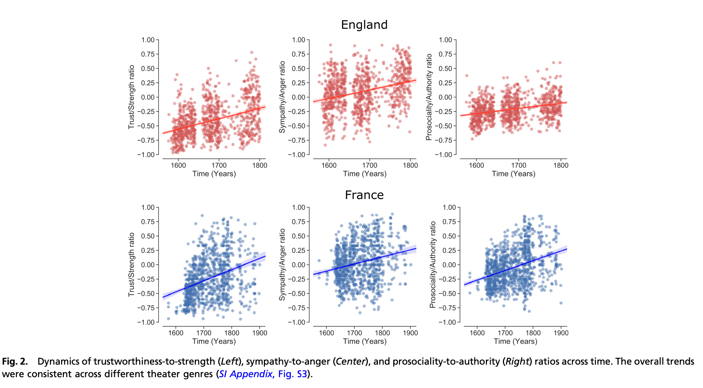

Slide 27
And how are we doing it?

Slide 28
A reminder:
Sentiment analysis requires:
Tokenizing
Counting words with a dictionary over space/time (or other unit…)
Denominating by totals

Slide 29
Sentiment analysis/dictionary-based methods
Relies on reference to a dictionary of words coded or classified in some way.
E.g., a list of cooperation words and dominance words
More frequently:
A list of sentiment words

Slide 30
Sentiment analysis/dictionary-based methods
Where do the dictionaries come from?
Pre-packaged
Domain specific
Pre-packaged: e.g., AFINN or bing or LIWC
Domain specific: e.g., tolerance or… ideas?

Slide 31
Sentiment analysis/dictionary-based methods
Where do the dictionaries come from?
Pre-packaged
E.g., AFINN: https://darenr.github.io/afinn/
Check out how built at http://www2.imm.dtu.dk/pubdb/edoc/imm6006.pdf Guesses as to how built?
E.g. bing
Check out how built at https://dl.acm.org/doi/pdf/10.1145/1014052.1014073
Guesses as to how built?
E.g. nrc
Check out how built at https://arxiv.org/pdf/1308.6297.pdf
Guesses as to how built

Slide 32
Sentiment analysis/dictionary-based methods
Where do the domain-specific dictionaries come from?
User-generated
E.g., a list of tolerance/cooperation words and a list of dominance words,
enhanced with WordNet (embeddings… to come later in term). Sometimes called label propagation.
E.g., a set of democracy-related terms. Keyed to a reliable index of related terms (e.g. search Freedom House). By anchoring to this, removes (some) arbitrariness of researcher decisions

Slide 33
Some methodological considerations
Are sentiment dictionaries applicable across contexts/domains?
How do we ‘discipline’ dictionary generation?
How do we validate our dictionary?

Slide 34
The course book...

Slide 35
https://cjbarrie.github.io/CTA-ED/

Slide 36
Thanks!
christopher.barrie@ed.ac.uk
https://www.cjbarrie.com/
@cbarrie

